Slide 1
DRAM Basics
Slides adapted by: Sparsh Mittal
Courtesy: Onur Mutlu

Slide 2
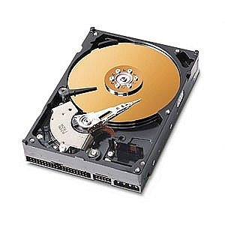
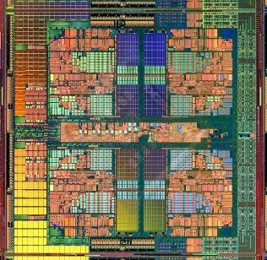
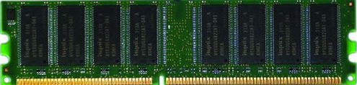
The Main Memory System
Main memory is a critical component of all computing systems: server, mobile, embedded, desktop, sensor
Processor
and caches
Main Memory
Storage (SSD/HDD)

Slide 3
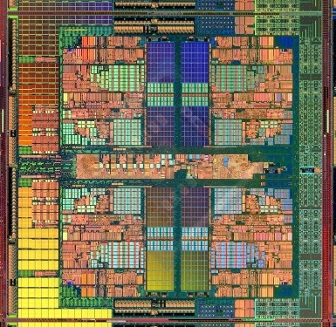
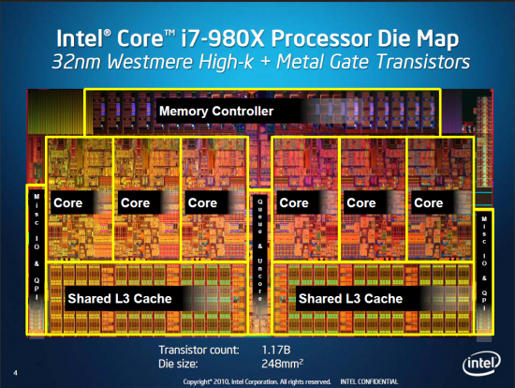
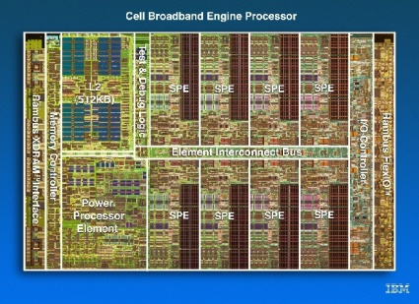
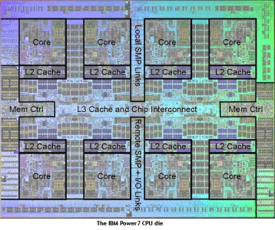
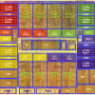
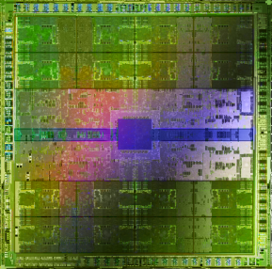
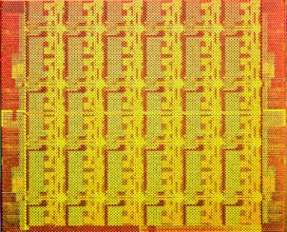
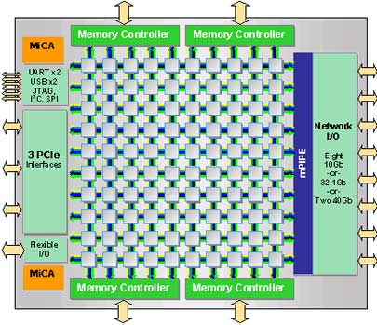
Example Trend: Many Cores on Chip
Simpler and lower power than a single large core
Large scale parallelism on chip
Intel Core i7 8 cores
IBM Cell BE 8+1 cores
IBM POWER7
8 cores
AMD Barcelona
4 cores
Nvidia Fermi
448 “cores”
Intel SCC
48 cores, networked
Tilera TILE Gx
100 cores, networked
Sun Niagara II
8 cores

Slide 4
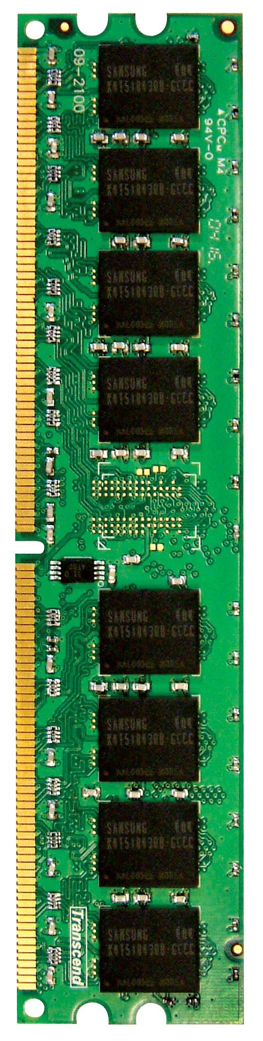

Main Memory in the System
CORE 0
L2 CACHE 1
CORE 1
L2 CACHE 0
SHARED L3 CACHE
DRAM INTERFACE
DRAM MEMORY CONTROLLER
DRAM BANKS
L2 CACHE 2
CORE 3
CORE 2
L2 CACHE 3

Slide 5
Memory Technology: DRAM
Dynamic random access memory
Capacitor charge state indicates stored value
Whether the capacitor is charged or discharged indicates storage of 1 or 0
1 capacitor
1 access transistor
Capacitor leaks through the RC path
DRAM cell loses charge over time
DRAM cell needs to be refreshed
row enable
_bitline

Slide 6
The DRAM Subsystem Down-to-top view

Slide 7
DRAM Subsystem Organization
Channel
DIMM
Rank
Chip (aka device)
Bank
Row/Column
DIMM = dual in-line memory module
DIMM is also just called module

Slide 8
Page Mode DRAM
A DRAM bank is a 2D array of cells: rows x columns
A “DRAM row” is also called a “DRAM page”
“Sense amplifiers” also called “row buffer”
Each address is a <row,column> pair
Access to a “closed row”
Activate command opens row (placed into row buffer)
Read/write command reads/writes column in the row buffer
Precharge command closes the row and prepares the bank for next access
Access to an “open row”
No need for activate command

Slide 9
DRAM Bank Operation
Access Address:
(Row 0, Column 0)
Columns
(Row 0, Column 1)
(Row 0, Column 85)
(Row 1, Column 0)
Row address 0
Row address 1
Row decoder
Rows
Row Buffer
CONFLICT !
HIT
Row 1
HIT
Row 0
Empty
Column address 0
Column mux
Column address 0
Column address 1
Column address 85
Data

Slide 10
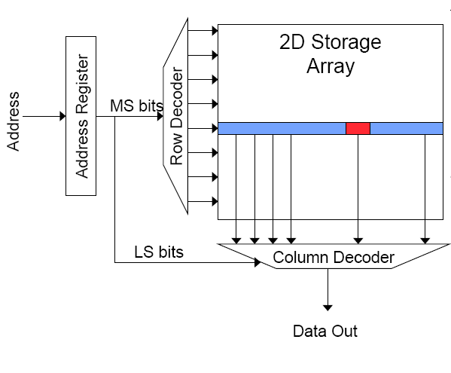
Memory Bank Organization and Operation
Read access sequence:
1. Decode row address & drive word-lines
2. Selected bits drive bit-lines
• Entire row read
3. Amplify row data
4. Decode column address & select subset of row
• Send to output
5. Precharge bit-lines
• For next access

Slide 11
The DRAM Chip
Consists of multiple banks (2-16 in Synchronous DRAM)
Banks share command/address/data buses
The chip itself has a narrow interface (4-16 bits per read)

Slide 12
DRAM Rank and Module
Rank: Multiple chips operated together to form a wide interface
All chips comprising a rank are controlled at the same time
Respond to a single command
Share address and command buses, but provide different data
A DRAM module consists of one or more ranks
E.g., DIMM (dual inline memory module)
This is what you plug into your motherboard
If we have chips with 8-bit interface, to read 8 bytes in a single access, use 8 chips in a DIMM

Slide 13
A 64-bit Wide DIMM (One Rank)

Slide 14
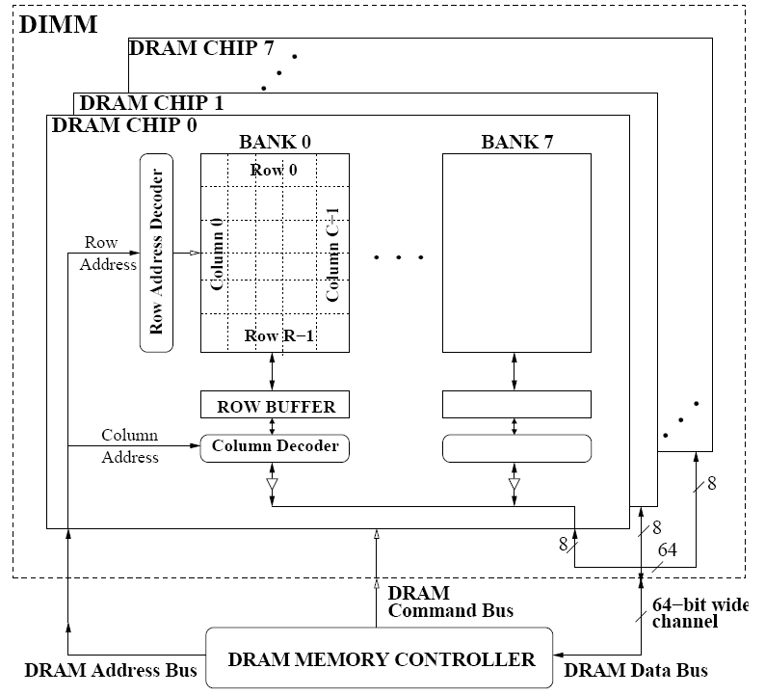
A 64-bit Wide DIMM (One Rank)
Advantages:
Acts like a high-capacity DRAM chip with a wide interface
Flexibility: memory controller does not need to deal with individual chips
Disadvantages:
Granularity: Accesses cannot be smaller than the interface width

Slide 15
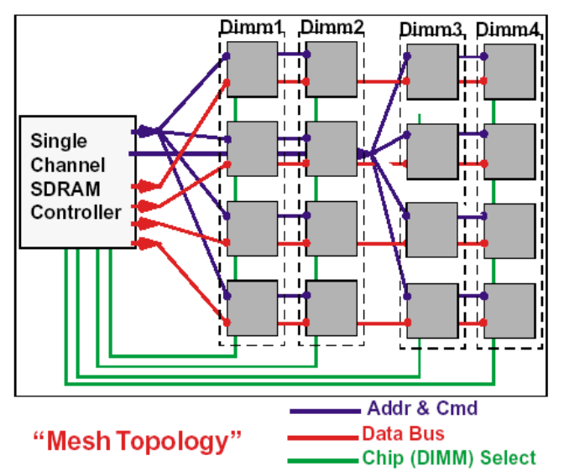
Multiple DIMMs
Advantages:
Enables even higher capacity
Disadvantages:
Interconnect complexity and energy consumption can be high

Slide 16
DRAM Channels
2 Independent Channels: 2 Memory Controllers (Above)
2 Dependent/Lockstep Channels: 1 Memory Controller with wide interface (Not shown above)

Slide 17
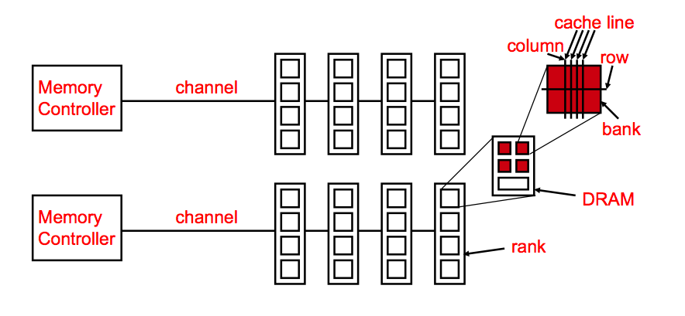
Generalized Memory Structure

Slide 18
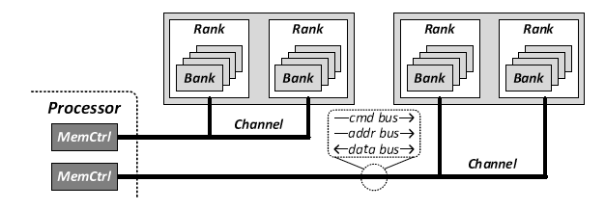
Generalized Memory Structure

Slide 19
The DRAM Subsystem The Top Down View

Slide 20
DRAM Subsystem Organization
Channel
DIMM
Rank
Chip (aka device)
Bank
Row/Column

Slide 21
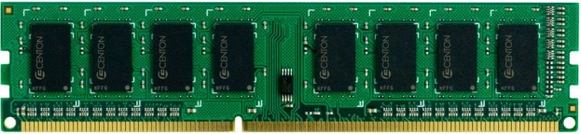
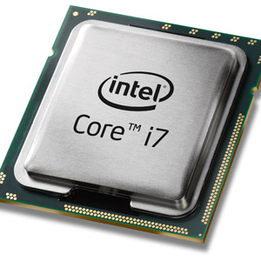
The DRAM subsystem
“Channel”
DIMM (Dual in-line memory module)
Processor
Memory channel
Memory channel

Slide 22
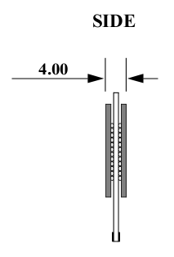
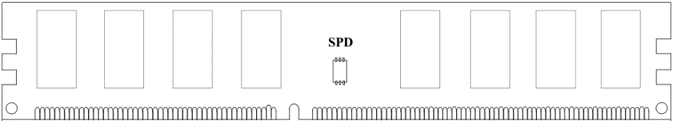
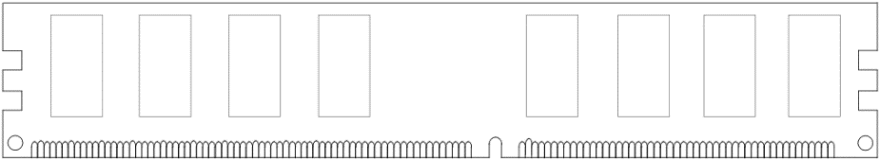
Breaking down a DIMM
DIMM (Dual in-line memory module)
Side view
Front of DIMM
Back of DIMM

Slide 23
Breaking down a DIMM
DIMM (Dual in-line memory module)
Side view
Front of DIMM
Back of DIMM
Rank 0: collection of 8 chips
Rank 1

Slide 24
Rank
Rank 0 (Front)
Rank 1 (Back)
<0:63>
<0:63>
Addr/Cmd
CS <0:1>
Data <0:63>
Memory channel

Slide 25
Breaking down a Rank
. . .
Chip 0
Chip 1
Chip 7
Rank 0
<0:63>
<0:7>
<8:15>
<56:63>
Data <0:63>

Slide 26
Breaking down a Chip
8 banks
Chip 0
Bank 0
<0:7>
<0:7>
<0:7>
...
<0:7>
<0:7>

Slide 27
Breaking down a Bank
2kB
1B (column)
row 16k-1
Bank 0
...
row 0
<0:7>
Row-buffer
1B
1B
1B
...
<0:7>

Slide 28
DRAM Subsystem Organization
Channel
DIMM
Rank
Chip
Bank
Row/Column

Slide 29
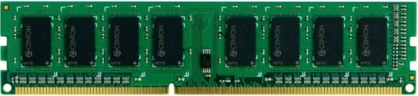
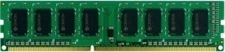

Example: Transferring a cache block
Physical memory space
0xFFFF…F
Channel 0
...
DIMM 0
Mapped to
0x40
Rank 0
64B
cache block
0x00

Slide 30
Example: Transferring a cache block
Physical memory space
Chip 0
Chip 1
Rank 0
Chip 7
0xFFFF…F
. . .
...
<0:7>
<8:15>
<56:63>
0x40
64B
cache block
Data <0:63>
0x00

Slide 31
Example: Transferring a cache block
Physical memory space
Chip 0
Chip 1
Rank 0
Chip 7
0xFFFF…F
. . .
Row 0
Col 0
...
<0:7>
<8:15>
<56:63>
0x40
64B
cache block
Data <0:63>
0x00

Slide 32
Example: Transferring a cache block
Physical memory space
Chip 0
Chip 1
Rank 0
Chip 7
0xFFFF…F
. . .
Row 0
Col 0
...
<0:7>
<8:15>
<56:63>
0x40
64B
cache block
Data <0:63>
8B
0x00
8B

Slide 33
Example: Transferring a cache block
Physical memory space
Chip 0
Chip 1
Rank 0
Chip 7
0xFFFF…F
. . .
Row 0
Col 1
...
<0:7>
<8:15>
<56:63>
0x40
64B
cache block
Data <0:63>
8B
0x00

Slide 34
Example: Transferring a cache block
Physical memory space
Chip 0
Chip 1
Rank 0
Chip 7
0xFFFF…F
. . .
Row 0
Col 1
...
<0:7>
<8:15>
<56:63>
0x40
8B
64B
cache block
Data <0:63>
8B
0x00
8B

Slide 35
Example: Transferring a cache block
Physical memory space
Chip 0
Chip 1
Rank 0
Chip 7
0xFFFF…F
. . .
Row 0
Col 1
...
<0:7>
<8:15>
<56:63>
0x40
8B
64B
cache block
Data <0:63>
8B
0x00
A 64B cache block takes 8 I/O cycles to transfer.
During the process, 8 columns are read sequentially.

Slide 36
Latency Components: Basic DRAM Operation
CPU → controller transfer time
Controller latency
Queuing & scheduling delay at the controller
Access converted to basic commands
Controller → DRAM transfer time
DRAM bank latency
Simple CAS (column address strobe) if row is “open” OR
RAS (row address strobe) + CAS if array precharged OR
PRE + RAS + CAS (worst case)
DRAM → Controller transfer time
Bus latency (BL)
Controller to CPU transfer time

Slide 37
Interaction with Virtual→Physical Mapping
Operating System influences where an address maps to in DRAM
Operating system can influence which bank/channel/rank a virtual page is mapped to.
Virtual Page number (52 bits)
Page offset (12 bits)
VA
Physical Frame number (19 bits)
Page offset (12 bits)
PA
Row (14 bits)
Bank (3 bits)
Column (11 bits)
Byte in bus (3 bits)
PA

Slide 38
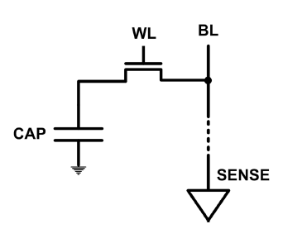
DRAM Refresh (I)
DRAM capacitor charge leaks over time
The memory controller needs to read each row periodically to restore the charge
Activate + precharge each row every N ms
Typical N = 64 ms
Implications on performance?
-- DRAM bank unavailable while refreshed
-- Long pause times: If we refresh all rows in burst, every 64ms the DRAM will be unavailable until refresh ends
Burst refresh: All rows refreshed immediately after one another
Distributed refresh: Each row refreshed at a different time, at regular intervals

Slide 39
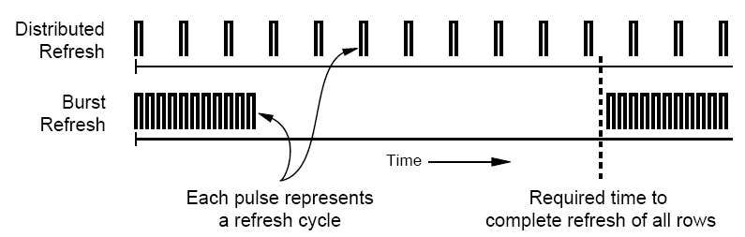
DRAM Refresh (II)
Distributed refresh eliminates long pause times
How else we can reduce the effect of refresh on performance?
Can we reduce the number of refreshes?

Slide 40
Memory Controllers

Slide 41
DRAM Scheduling Policies (I)
FCFS (first come first served)
Oldest request first
FR-FCFS (first ready, first come first served)
1. Row-hit first
2. Oldest first
Goal: Maximize row buffer hit rate → maximize DRAM throughput
Actually, scheduling is done at the command level
Column commands (read/write) prioritized over row commands (activate/precharge)
Within each group, older commands prioritized over younger ones

Slide 42
Row Buffer Management Policies
Open row
Keep the row open after an access
+ Next access might need the same row → row hit
-- Next access might need a different row → row conflict, wasted energy
Closed row
Close the row after an access (if no other requests already in the request buffer need the same row)
+ Next access might need a different row → avoid a row conflict
-- Next access might need the same row → extra activate latency
Adaptive policies
Predict whether or not the next access to the bank will be to the same row

